Slide 1
Strategy Pattern
Realizing the attack strategies in the video games
배강민
소프트웨어공학과
전남대학교

Slide 2
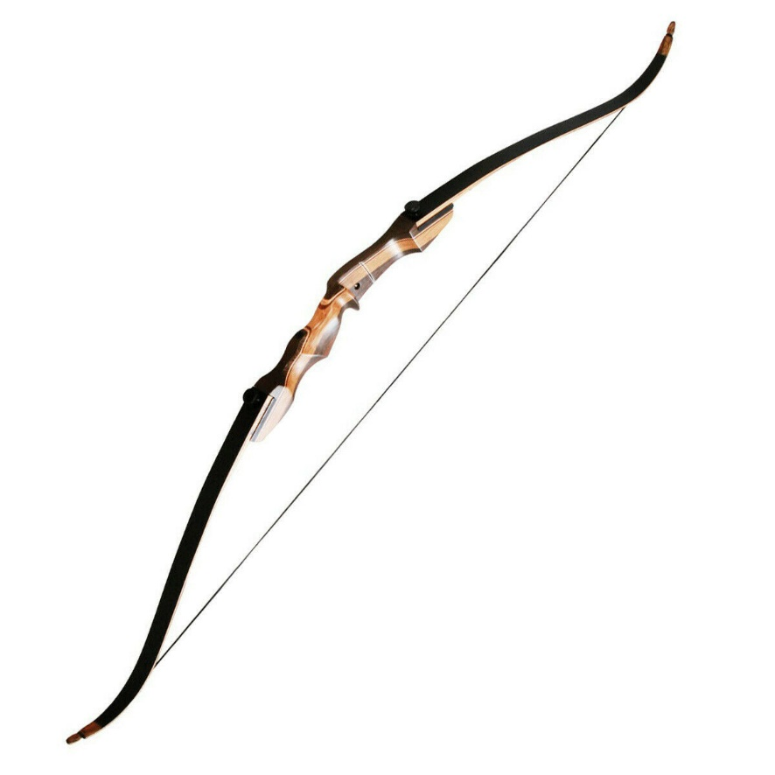
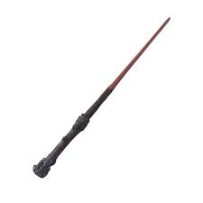

Strategy Pattern
‘Attack()’ function cannot reflect the attribute of weapon.
Attack()
Attack()
Attack()

Slide 3
Strategy Pattern
This way might be the solution?
Attack() -> Slash()
Attack() -> Shoot()
Attack() -> Cast()

Slide 4
Strategy Pattern
The content of the new codes is duplicated.
Slash()
Deal damage Range: short Physical
Attack()
Deal damage
Shoot()
Deal damage Range: long Physical
Cast()
Deal damage Range: long Magical
Also, this solution could cause the shotgun surgery.

Slide 5
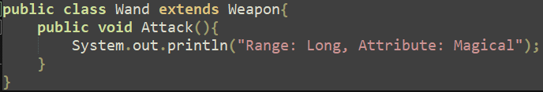
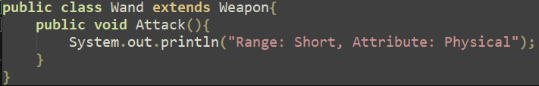
Strategy Pattern
Player has no mana to cast spell.
So, player’s wand can now only smack the enemies.
This solution violates the Open-Closed Principal.

Slide 6
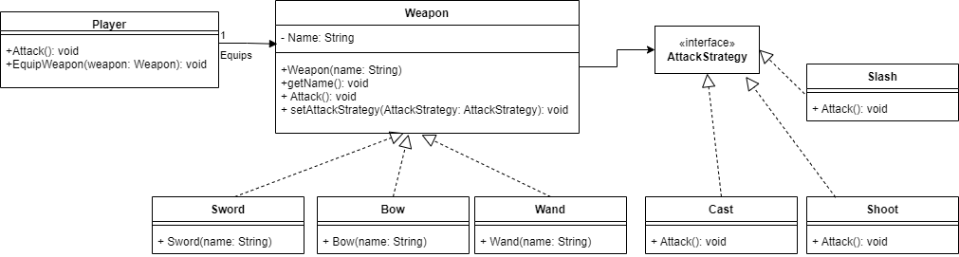
Strategy Pattern
The effective solution is encapsulating ‘Attack Strategies’.

Slide 7
Strategy Pattern
The main agent of attack is the player not the weapon.
public class Player{
private Weapon w;
public void EquipWeapon(Weapon weapon) {
this.w = weapon;
}
public void attack() {
w.attack();
}
}

Slide 8
Strategy Pattern
public abstract class Weapon{
private String name;
private AttackStrategy AttackStrategy;
public Weapon(String name) {
this.name = name;
}
public void getName() {
System.out.printf("Equipped Weapon: %s\n", name);
}
public void attack() {
AttackStrategy.attack();
}
public void setAttackStrategy(AttackStrategy AS) {
this.AttackStrategy = AS;
}
}

Slide 9
Strategy Pattern
Three types of weapon
public class Sword extends Weapon{
public Sword(String name) {
super(name);
}
}
public class Wand extends Weapon{
public Wand(String name) {
super(name);
}
}
public class Bow extends Weapon{
public Bow(String name) {
super(name);
}
}

Slide 10
Strategy Pattern
public interface AttackStrategy{
public void attack();
}
public class Slash implements AttackStrategy{
public void attack(){
System.out.println("Range: Short, Attribute: Physical");
}
}
public class Shoot implements AttackStrategy{
public void attack(){
System.out.println("Range: Long, Attribute: Physical");
}
}
public class Cast implements AttackStrategy{
public void attack(){
System.out.println("Range: Long, Attribute: Magical");
}
}

Slide 11
Strategy Pattern
Player has no mana to cast spell.
Player’s wand can now only smack the enemies.
public class test {
public static void main(String[] args) {
Player p = new Player();
Wand w = new Wand("Elder Wand");
p.EquipWeapon(w);
w.getName();
w.setAttackStrategy(new Cast());
p.attack();
System.out.println("\nYou are out of mana!");
w.setAttackStrategy(new Slash());
p.attack();
}
}

Slide 12

Strategy Pattern
Result

Slide 13
Q&A
Q: According to UML diagram, relationship between Weapon and Attack strategy is 3 X 3.
Which means sword can cast spells, and player can shoot the enemy with the wand.
This situation would be perceptible in ‘The environment of game playing’ not ‘The logicality of code?’

Slide 14
감사합니다

